Slide 1
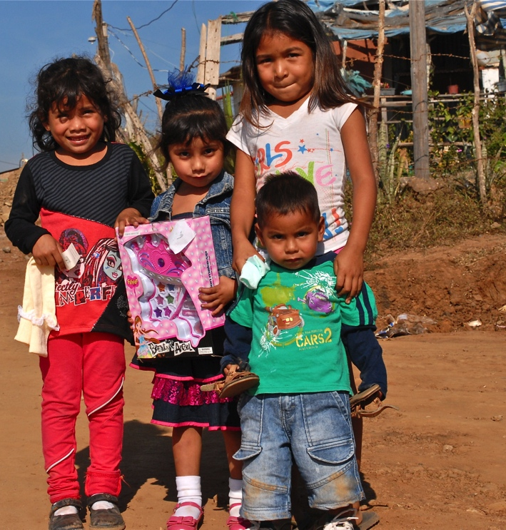
Breakfast of the Chickens
Desayuno de los Pollos

Slide 2
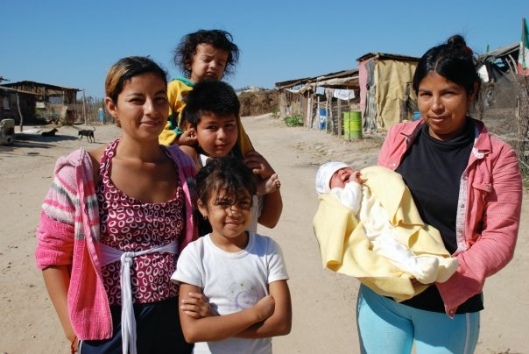
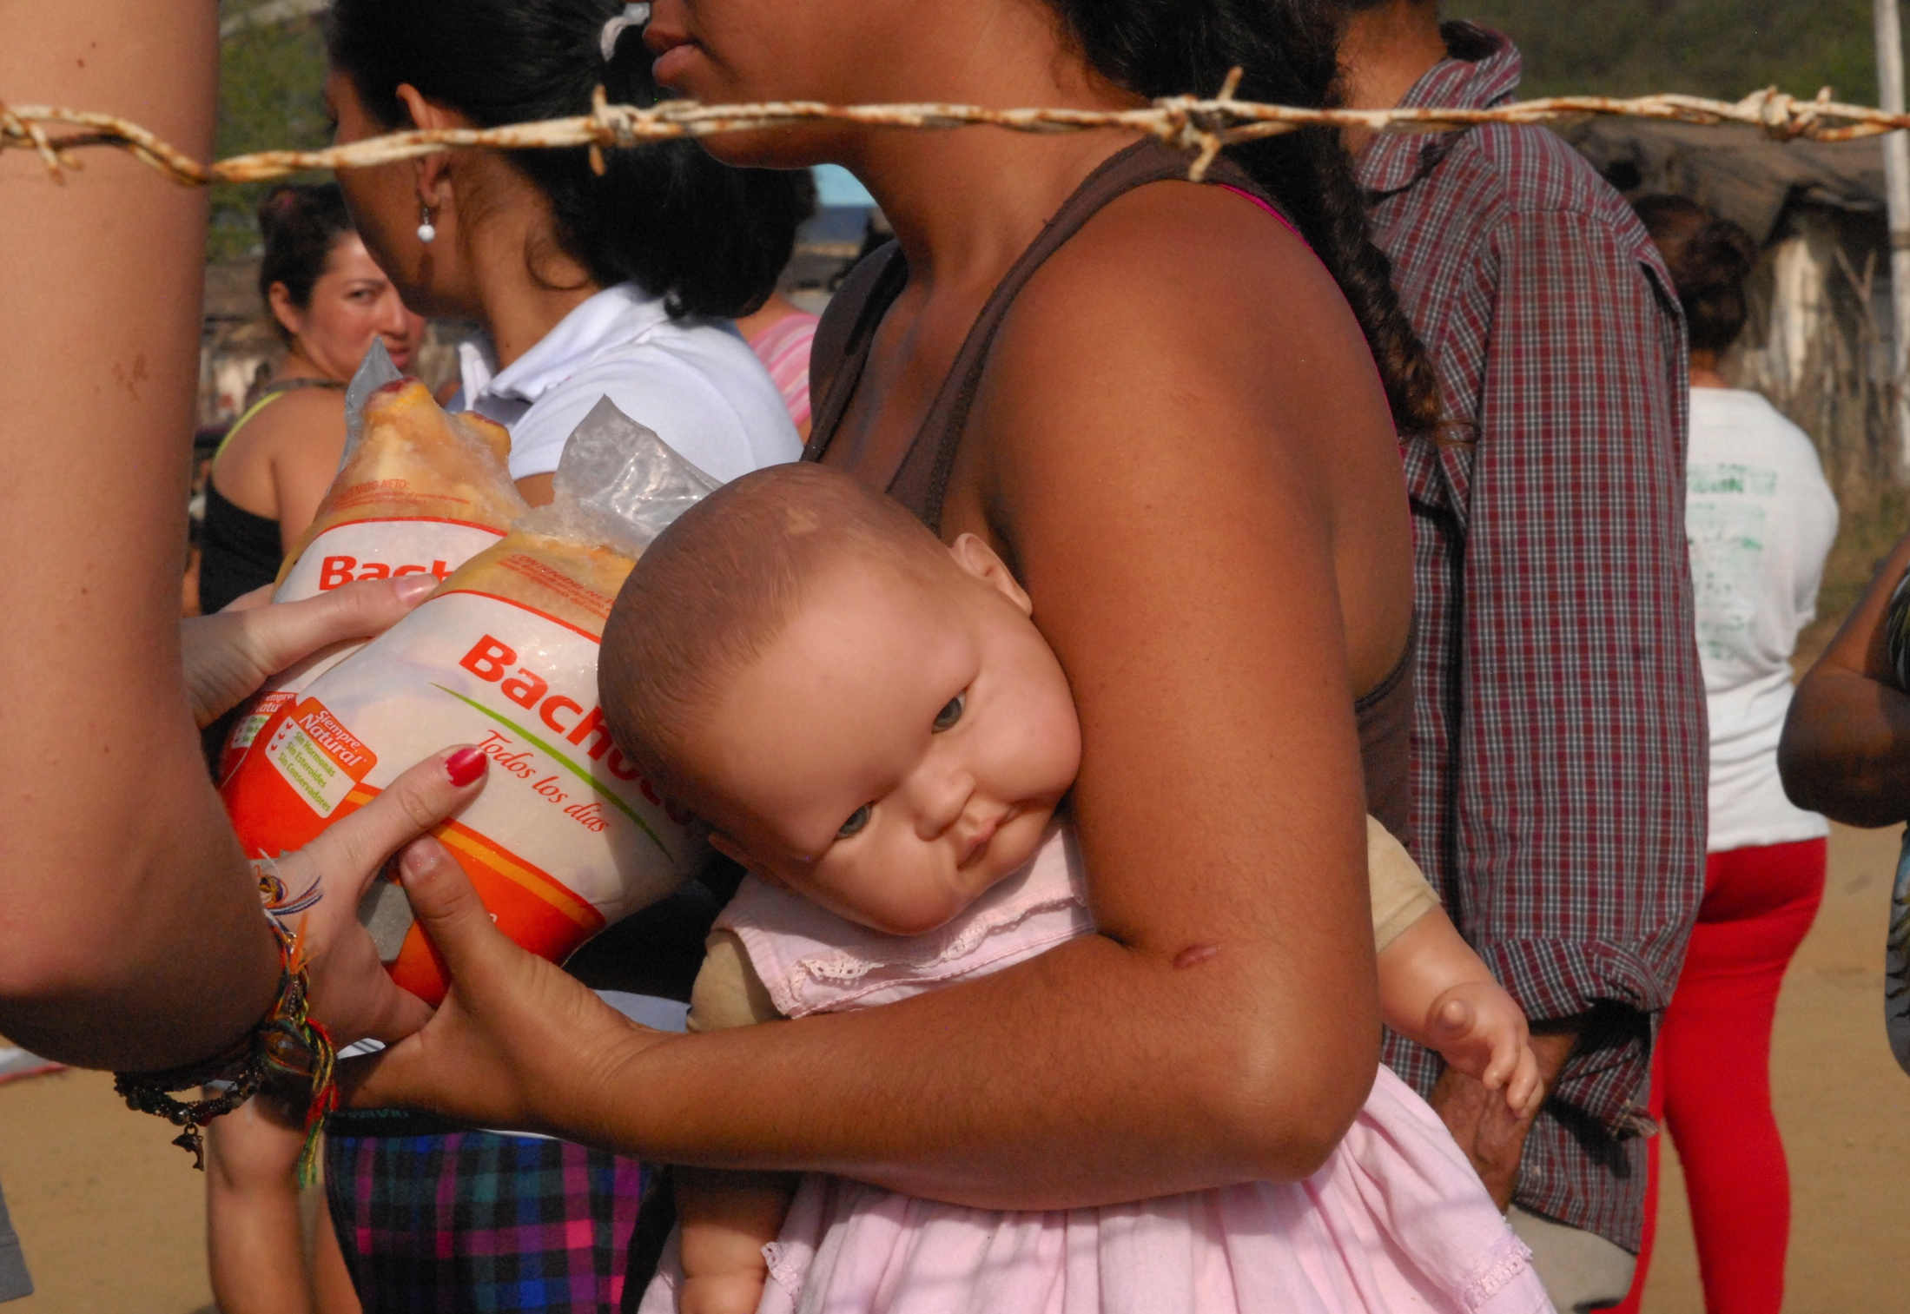
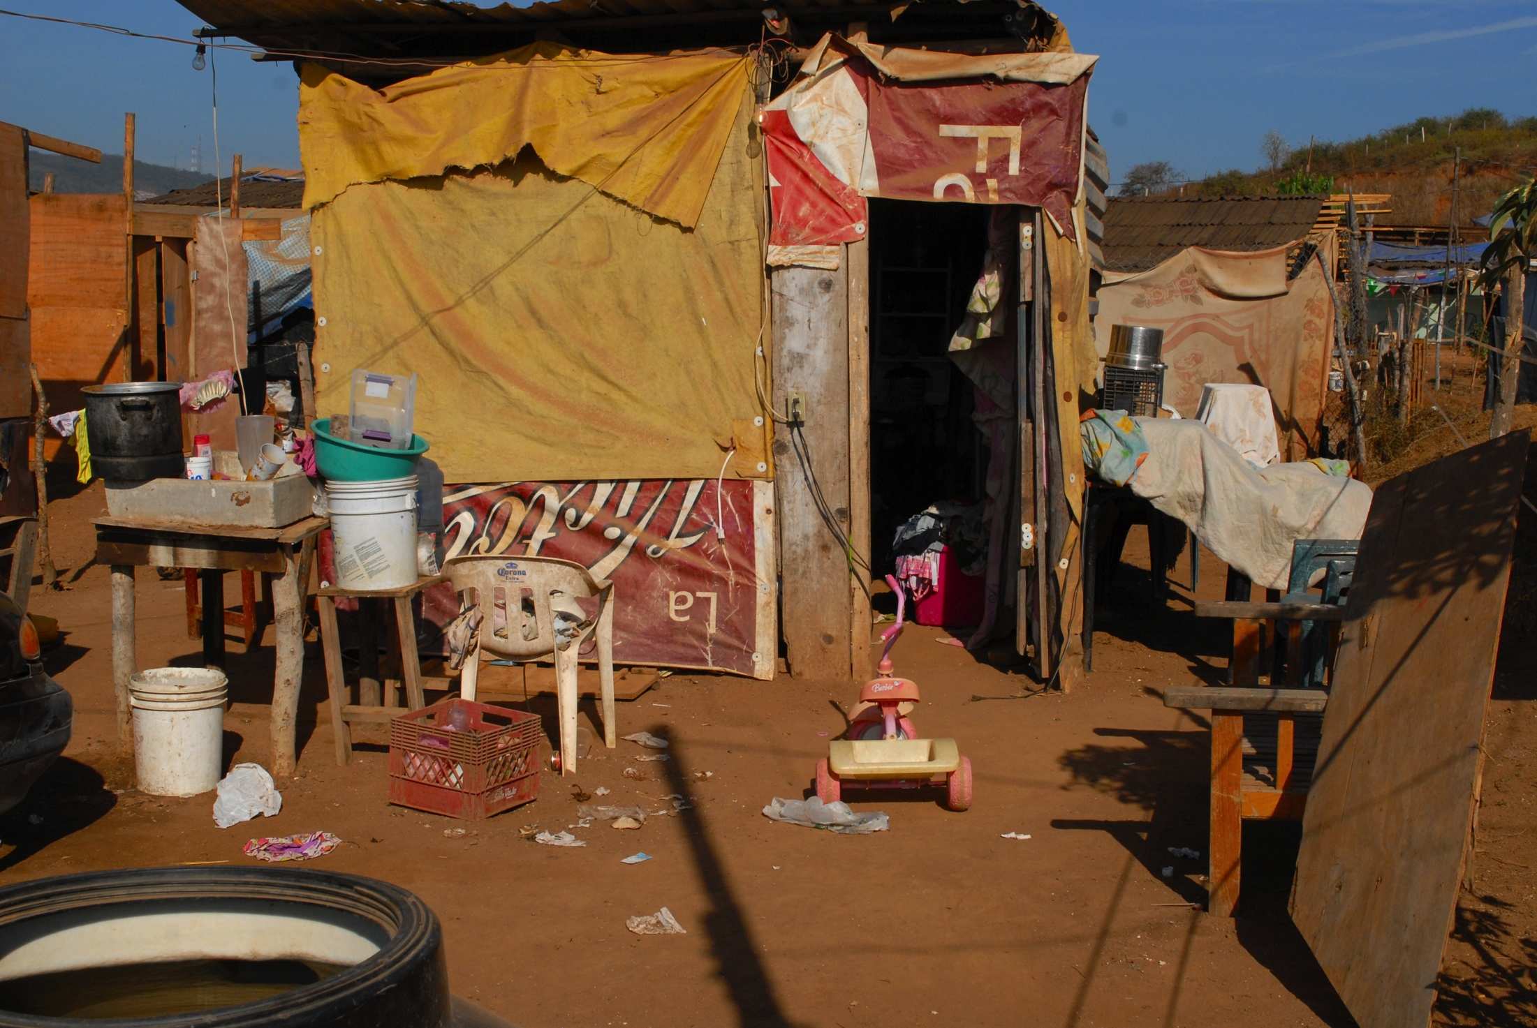

Slide 3
What is it?
A community effort to feed over 2300 families in Mazatlán’s poorest communities: whole chickens and two week’s worth of rice, beans, oil, tuna…
A joint effort of local Mazatlecos and expatriates
Started by Yolanda Medina in 1990
All volunteer, no government support

Slide 4
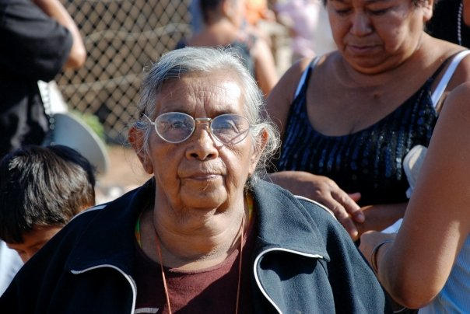
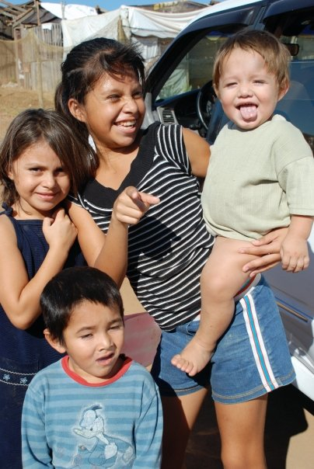
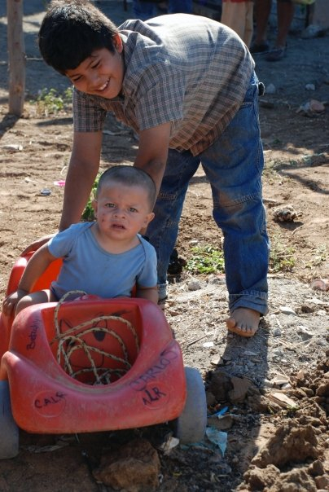

Slide 5
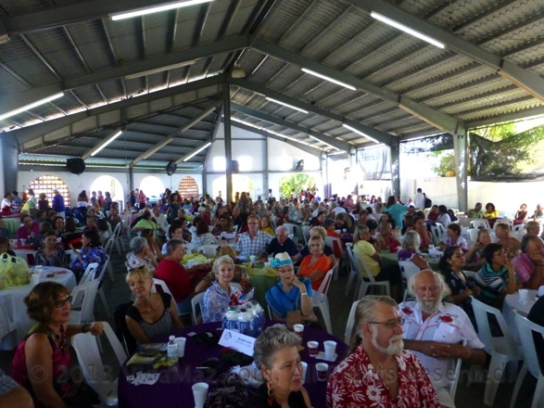
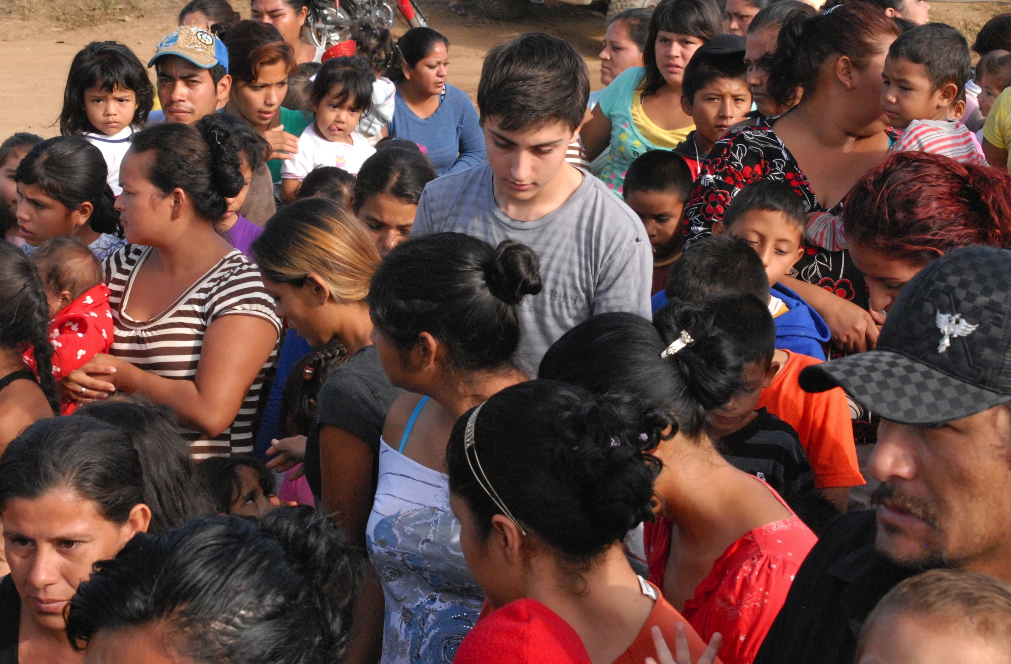
What is involved?
A Fundraiser Breakfast
Sat. Dec. 12, 2015
8 am – about 11:30 am
170 pesos/person
Handing Out of the Food
Wednesday December 24th
6:30 am – about 11:00 am
Free for everyone; wear holiday attire and a big smile

Slide 6
How did it come to be?
In 1990, Yolanda Medina’s daughter, María Yolanda, laying the hospital, dying… the door opened and a stranger brought in two Christmas dinners, for her husband and her. She never forgot.
For the next several years they worked with the Culinary Academy to provide dinners for dozens of families. It got so expensive and labor intensive.
For the past 20 or so years it has existed as it does today, involving more people each year.

Slide 7
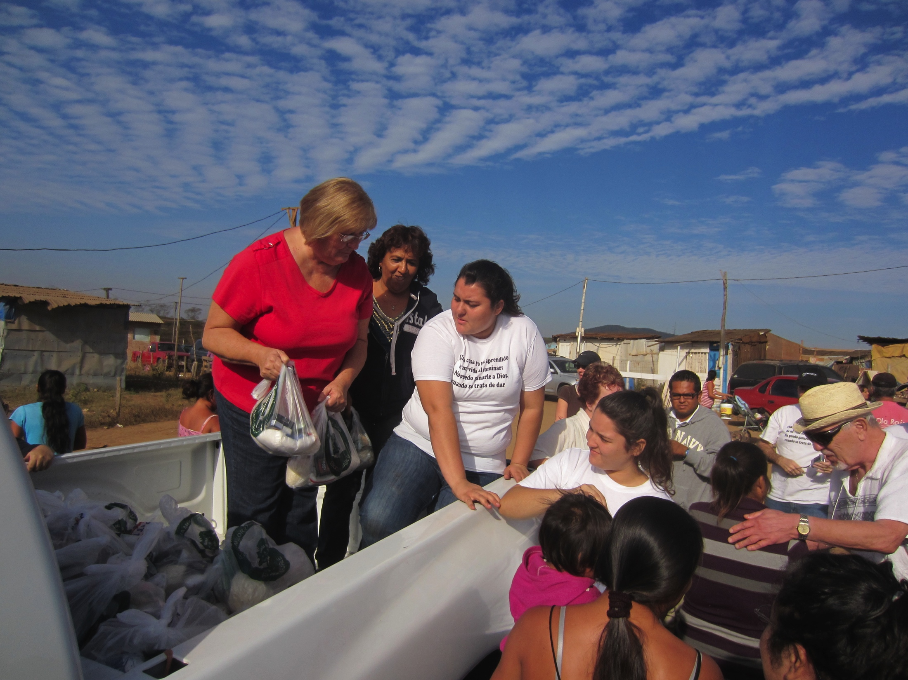
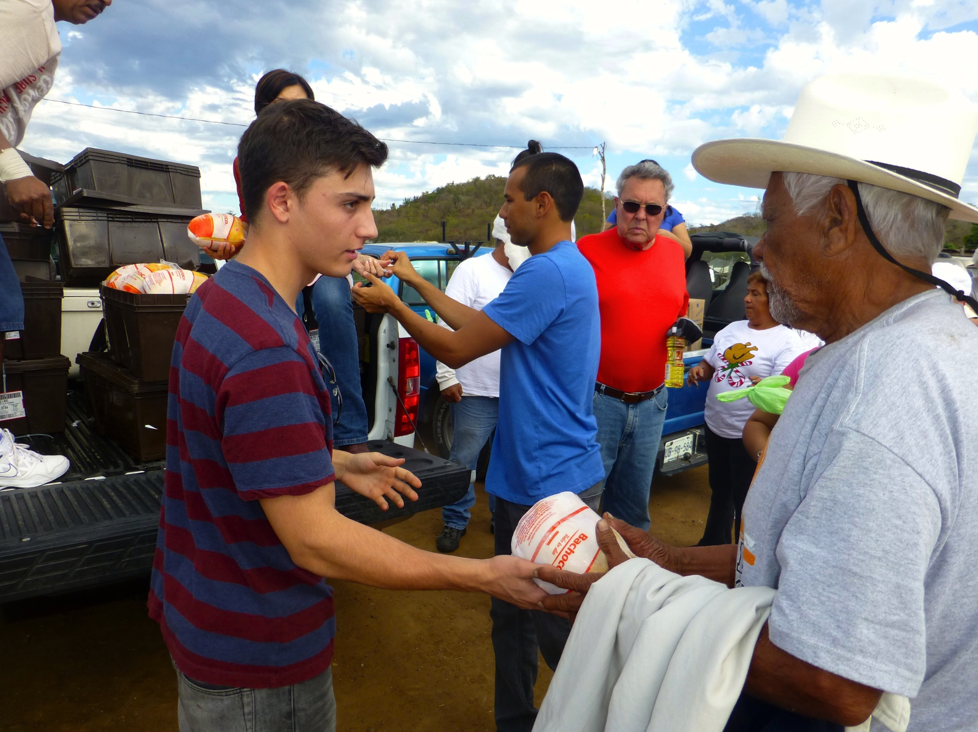
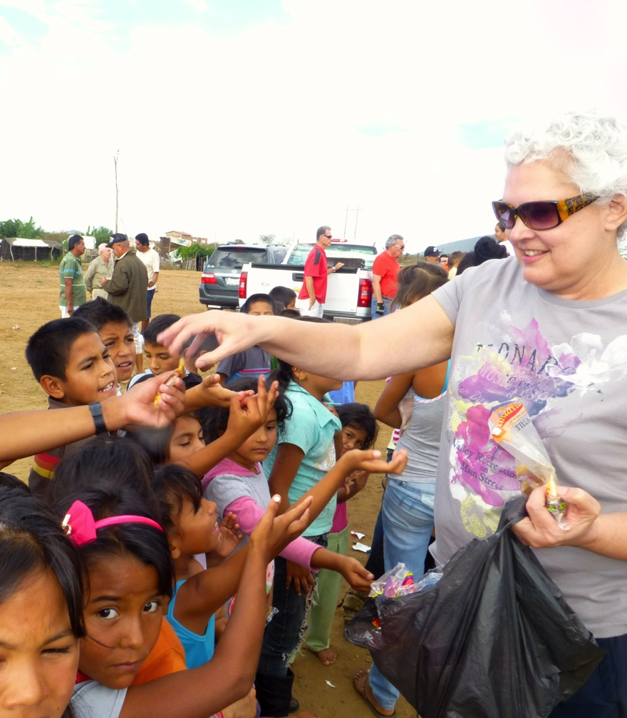
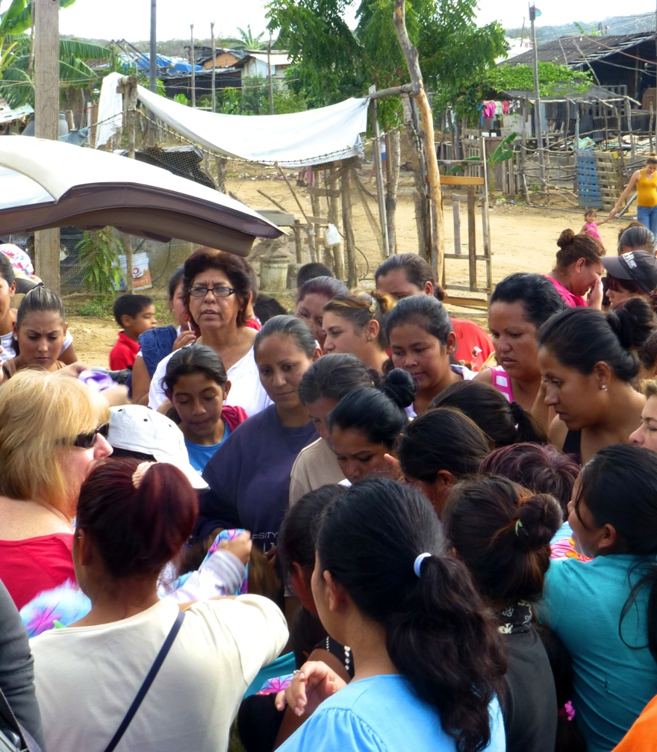

Slide 8
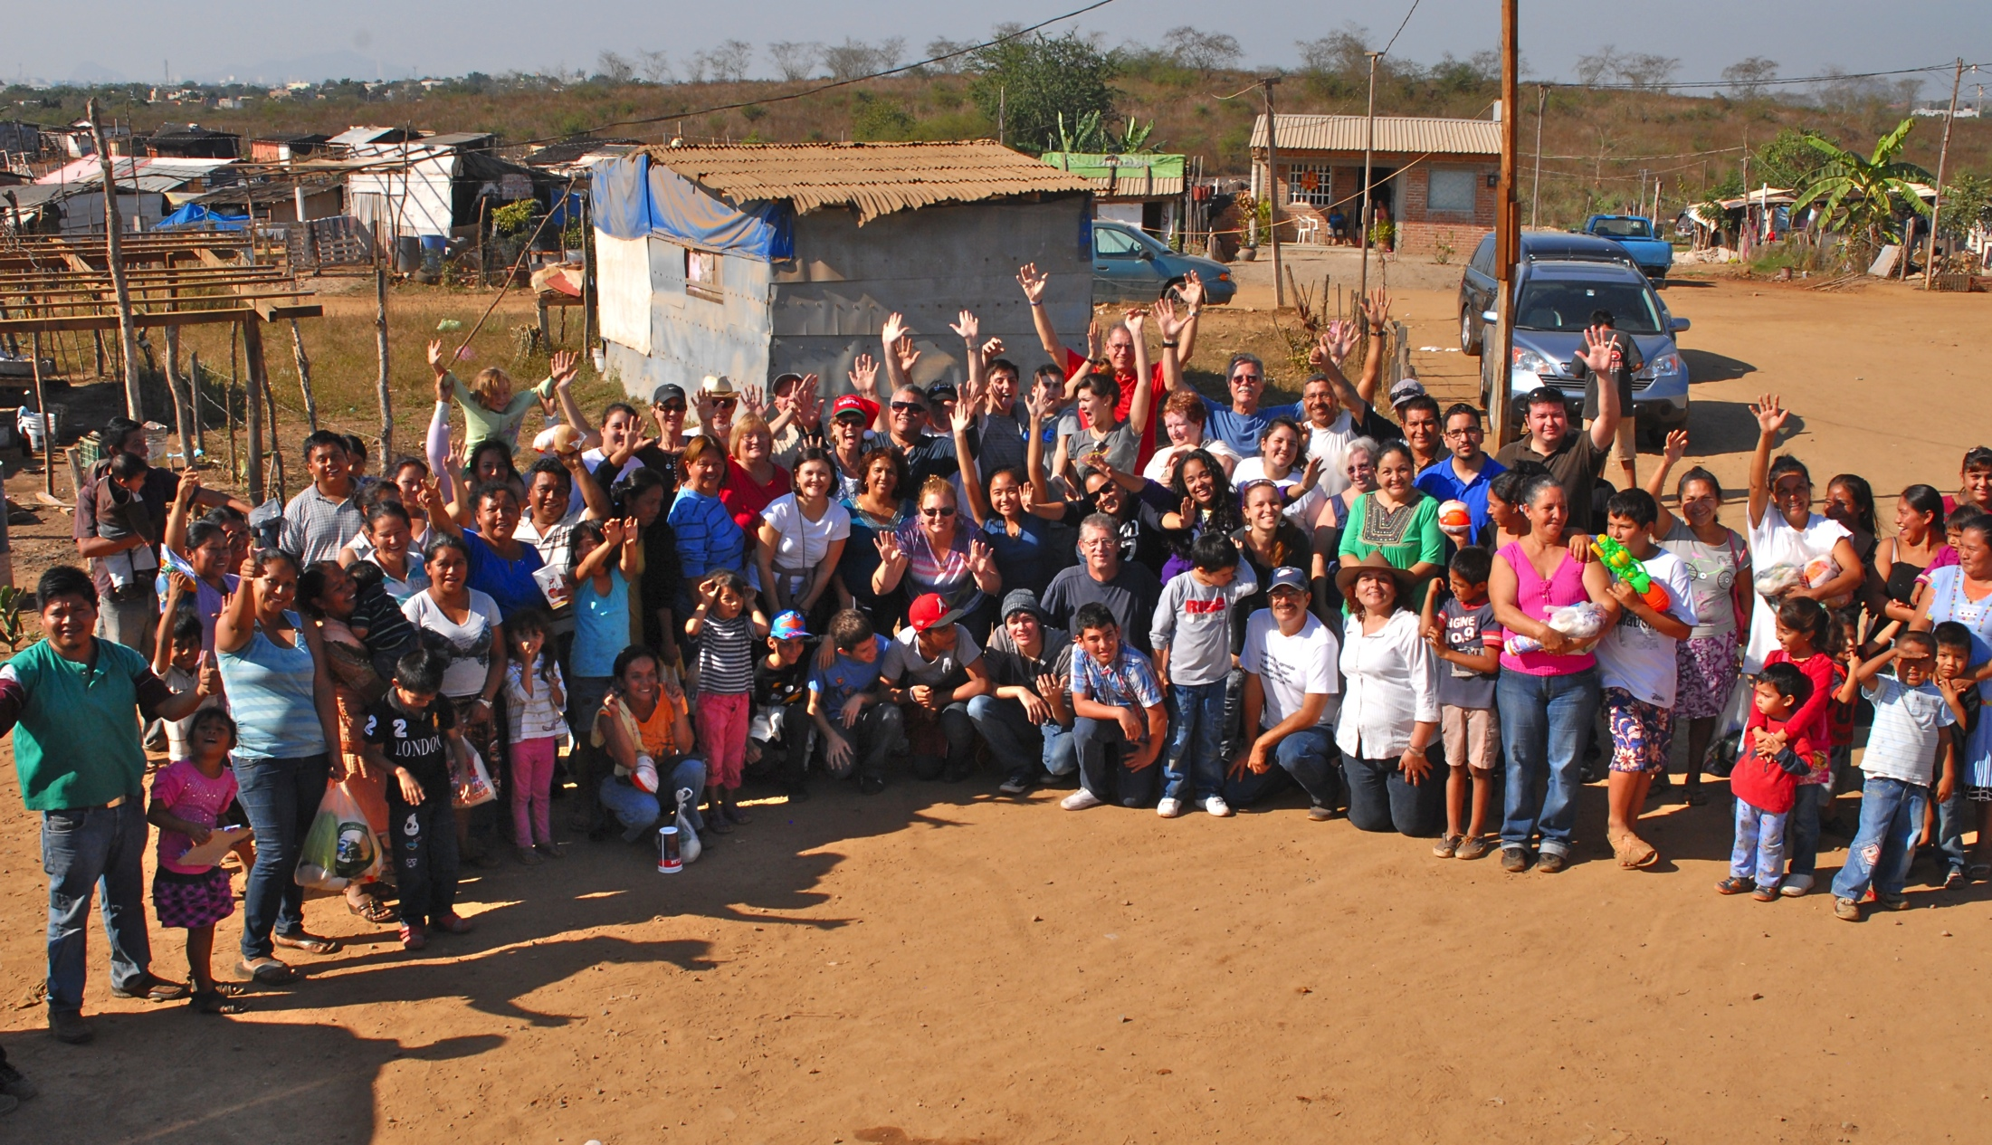

Slide 9
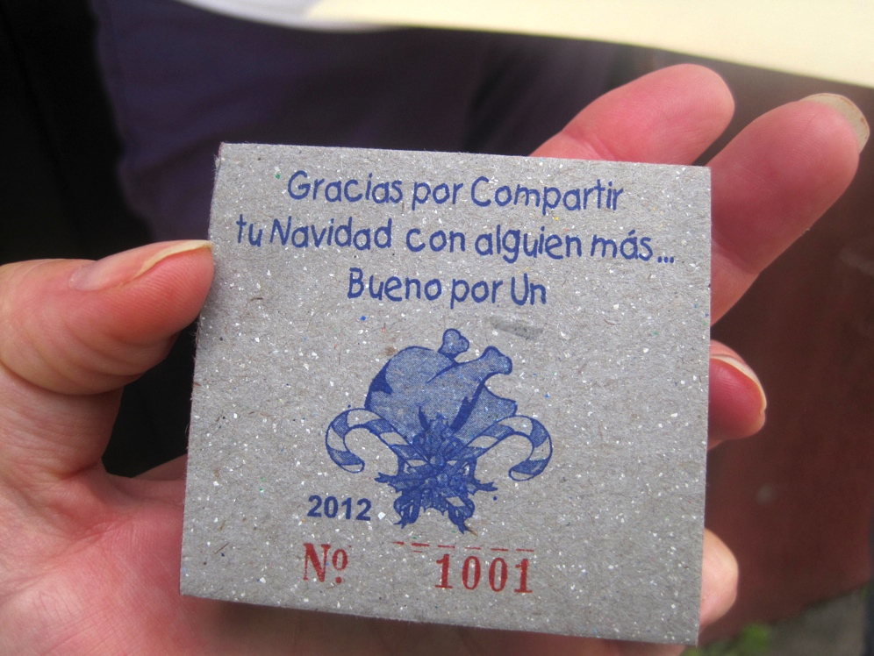
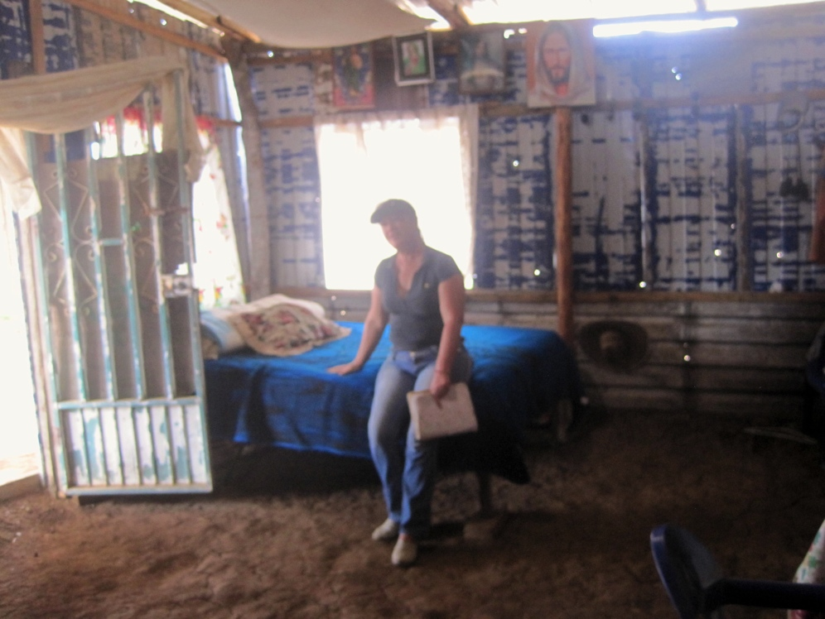
To ensure equity
We pass out tickets to individual families, accompanied by community leaders. Must have a ticket to get a chicken or food.

Slide 10
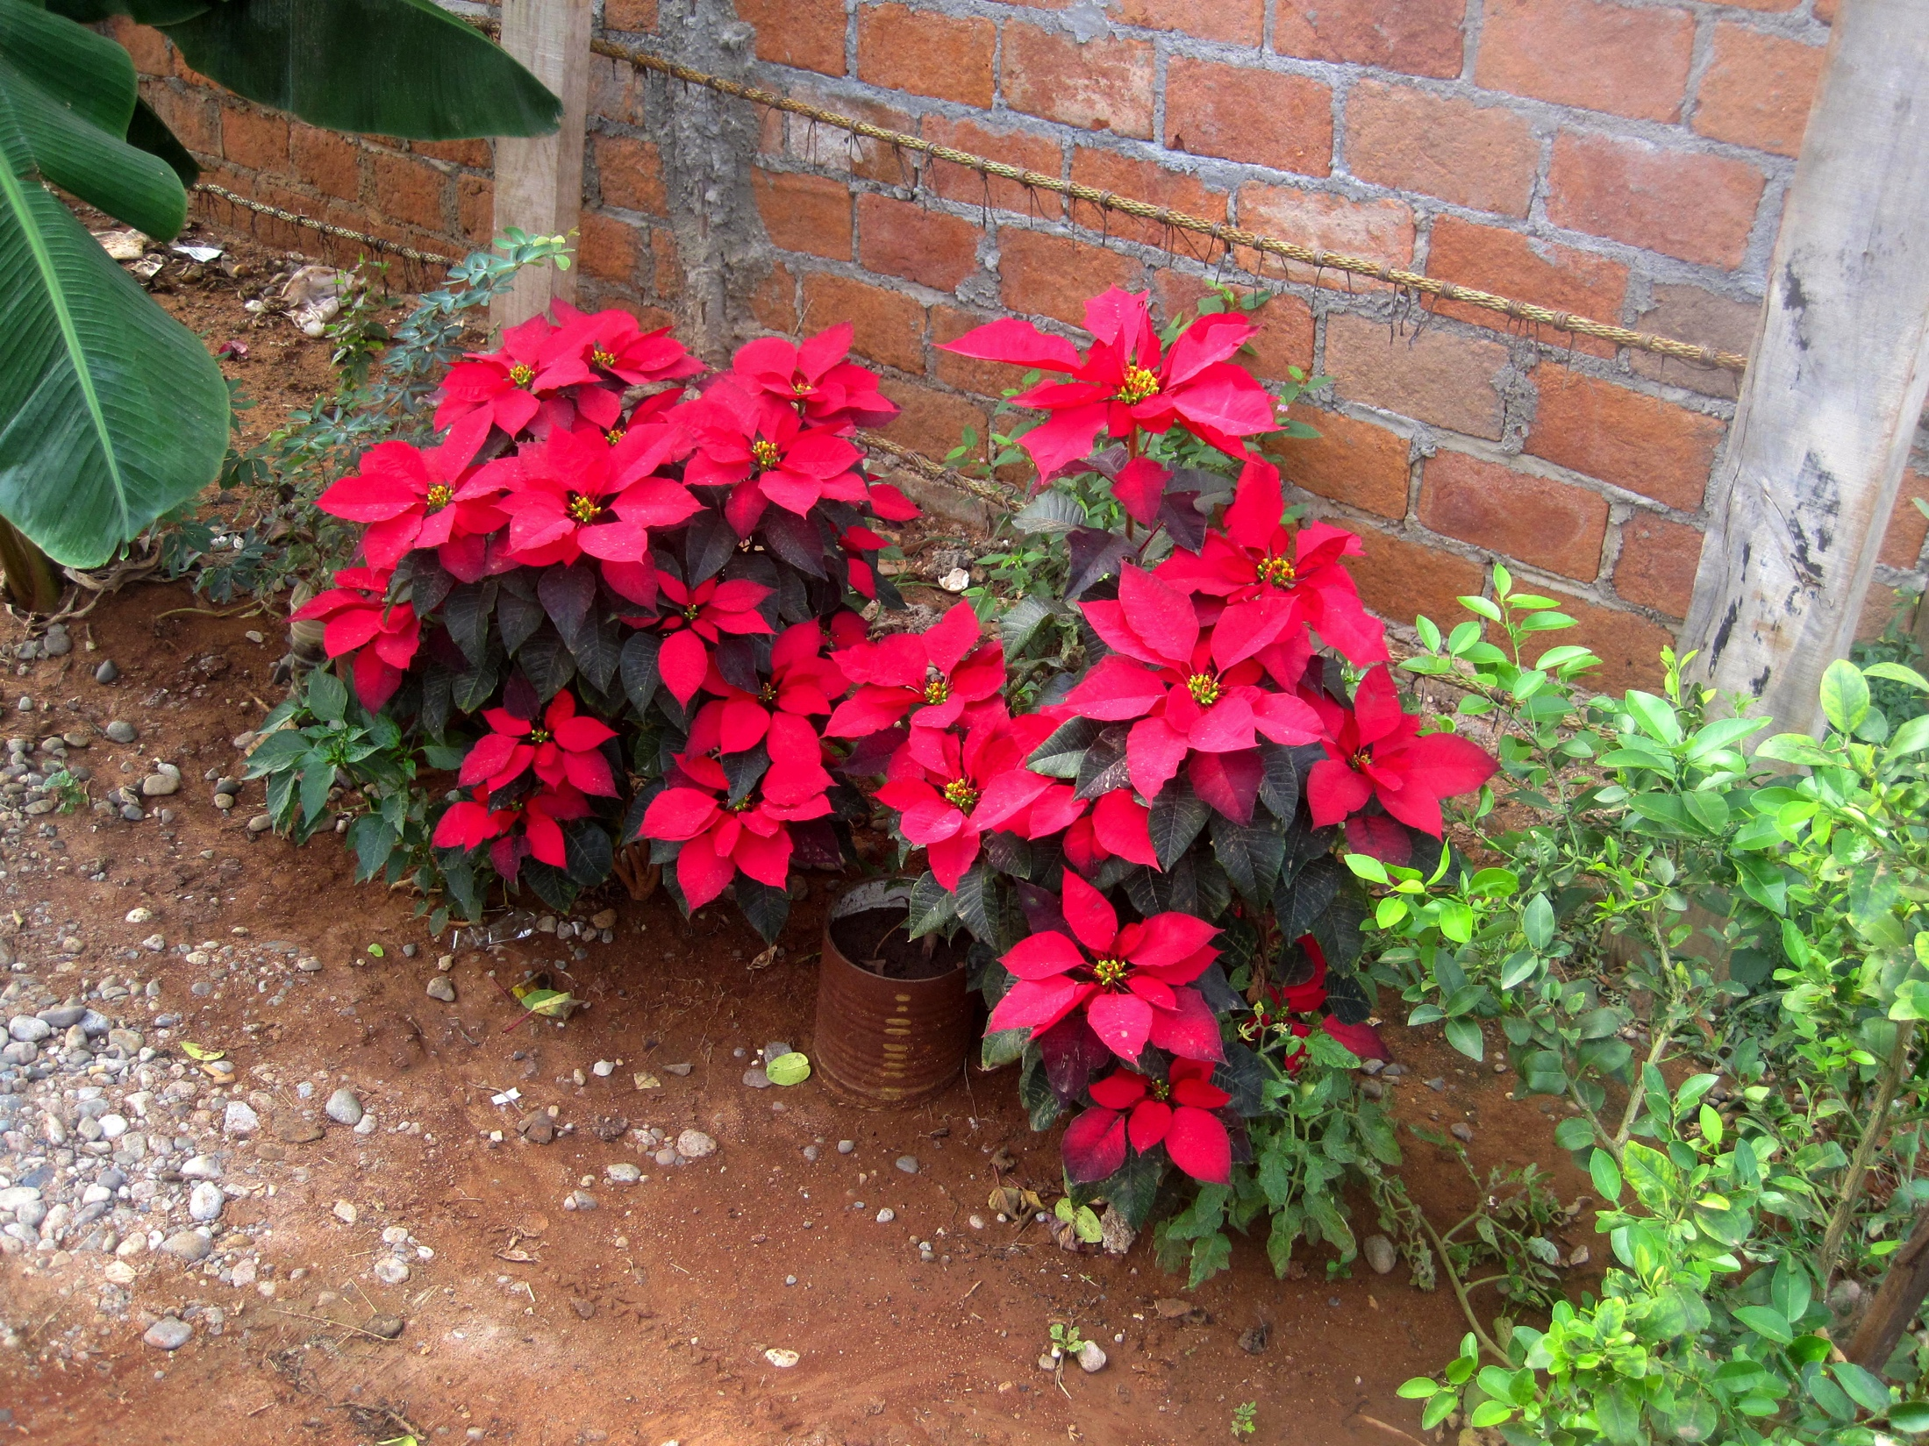
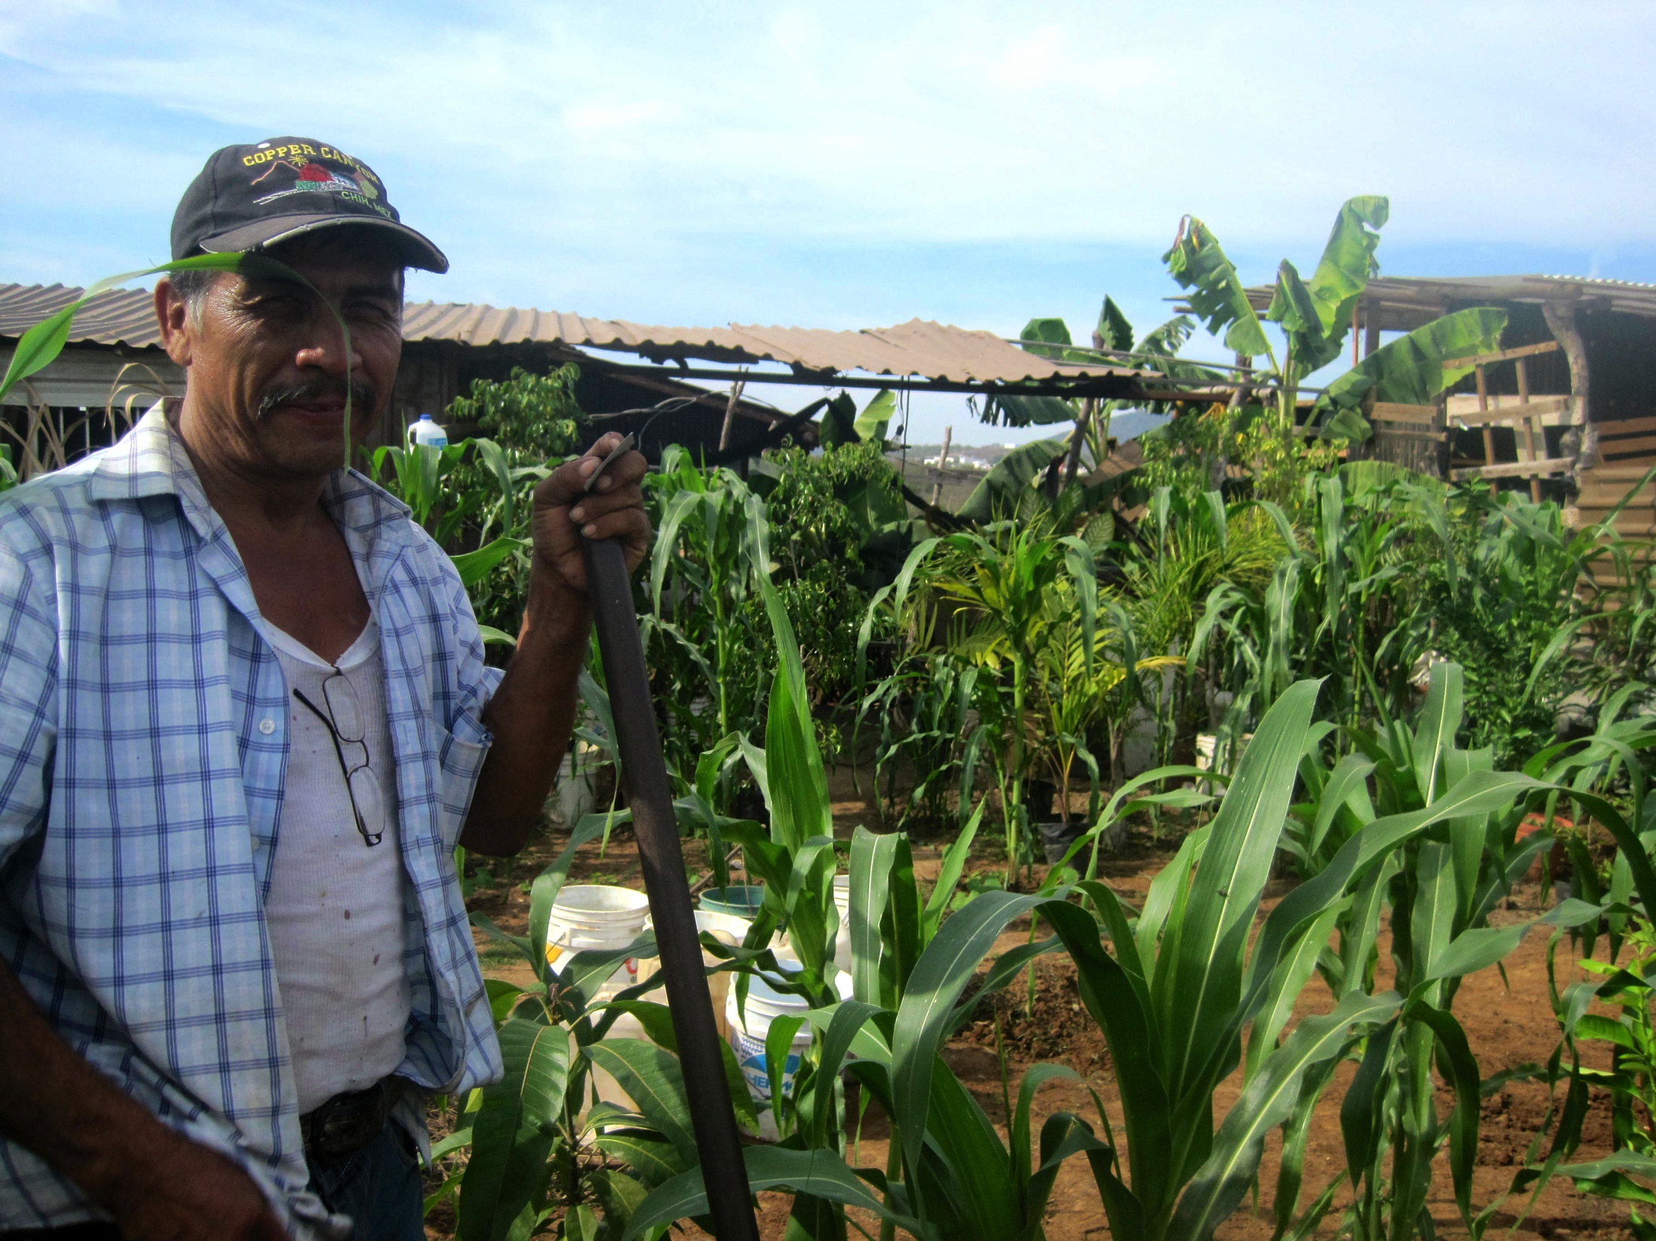
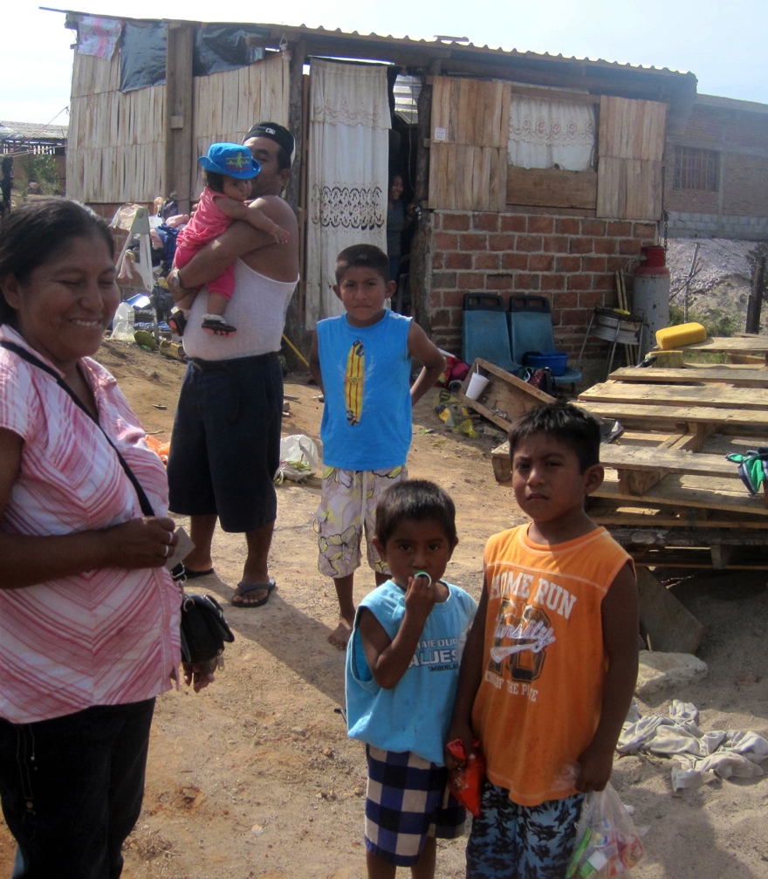
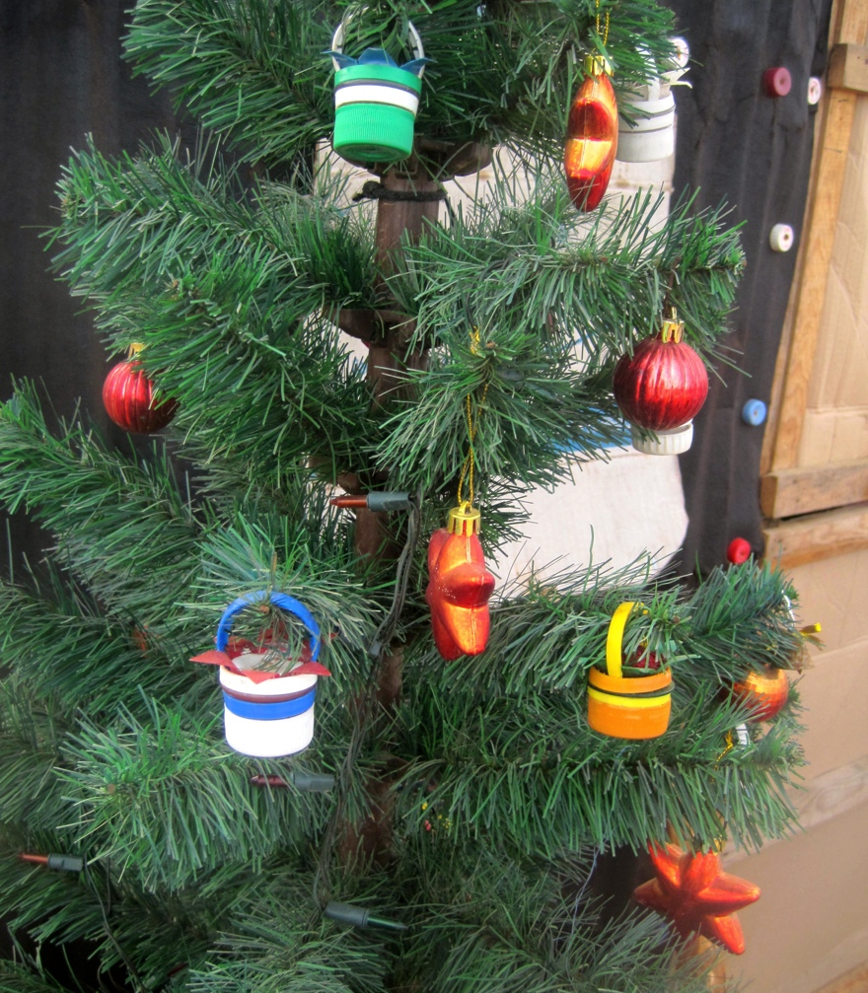

Slide 11
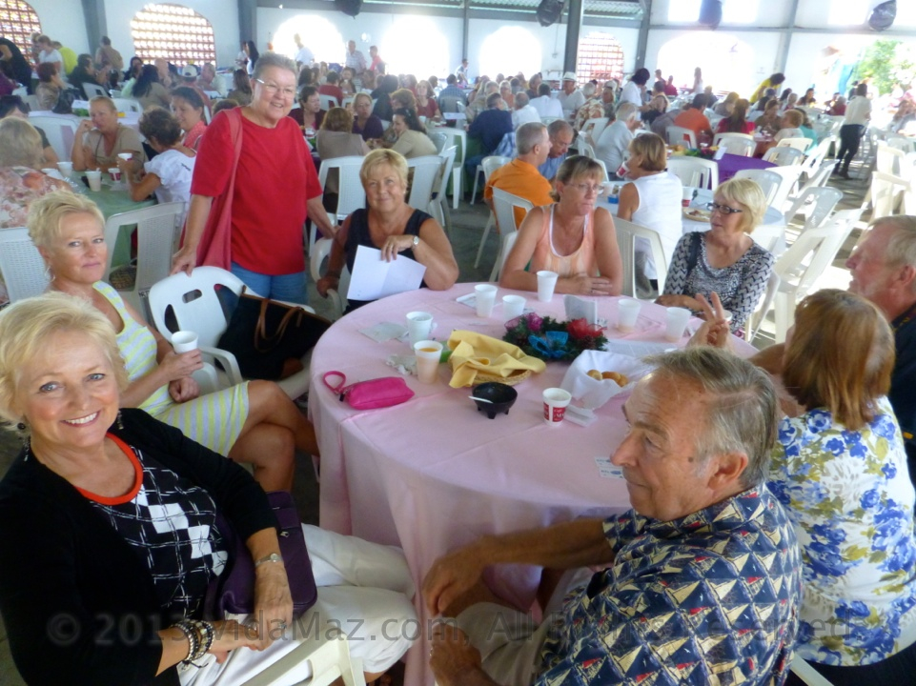
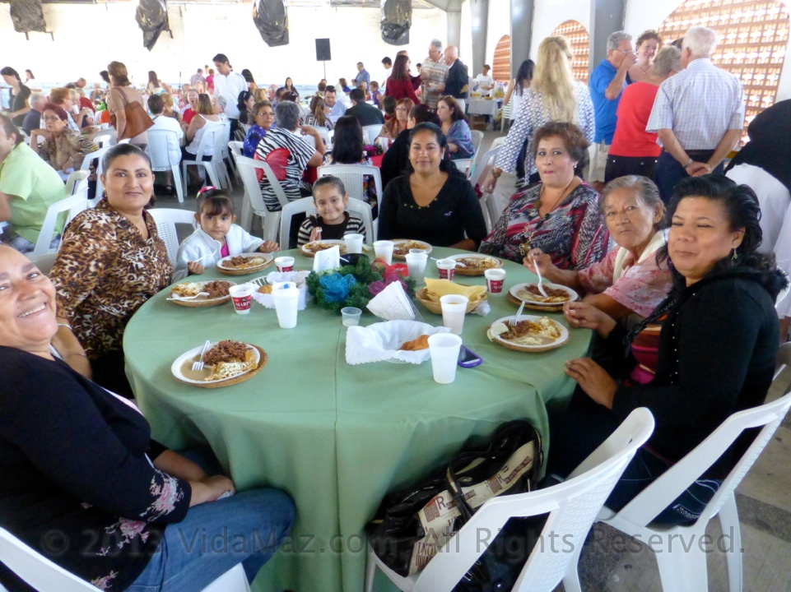
How can we help?
Attend the breakfast and get your friends to join us!

Slide 12
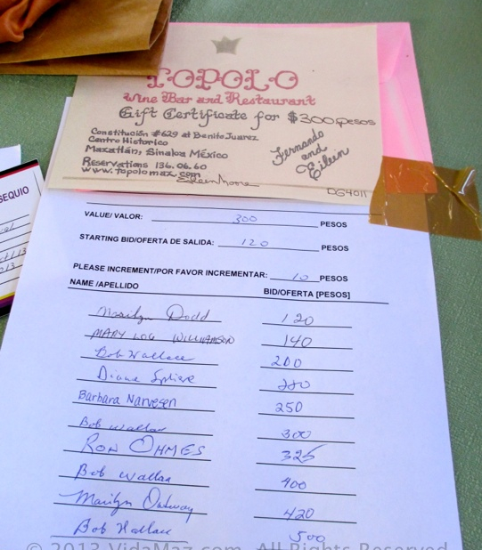
Gather auction items
Silent and Live Auctions
Gift certificates to restaurants, hotels
Gifts from stores (candles, scarves…)
Handmade items of excellent quality
Artwork you are no longer in need of

Slide 13
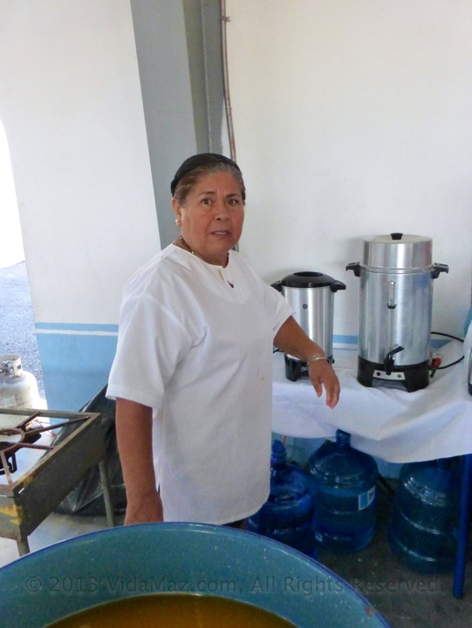
Be a cook!
Work with the ladies who have always cooked, and learn how to make some typical Mazatleco dishes!
At least some Spanish will be helpful.

Slide 14
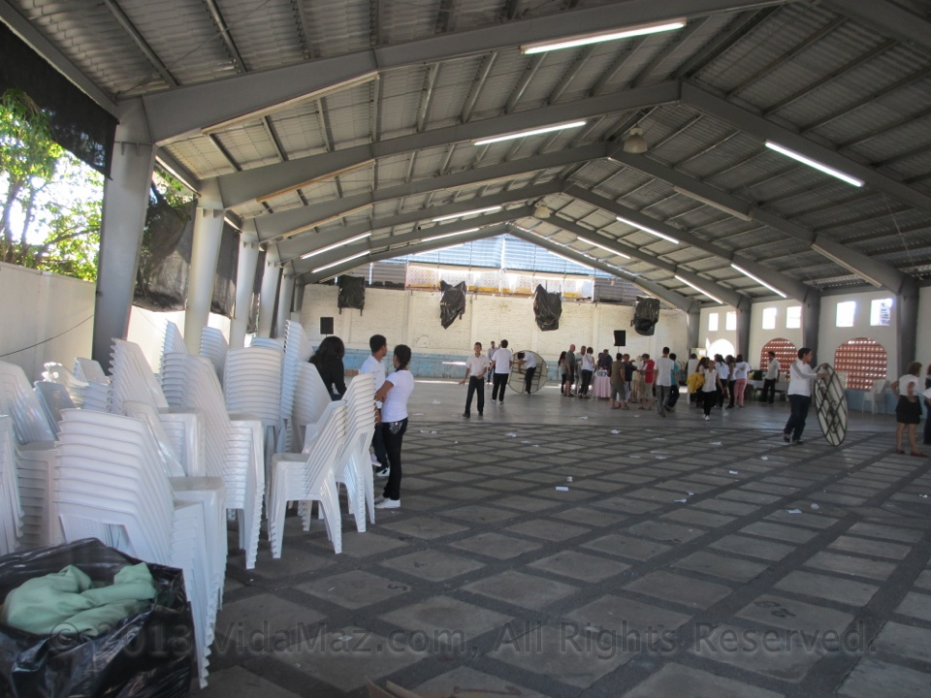
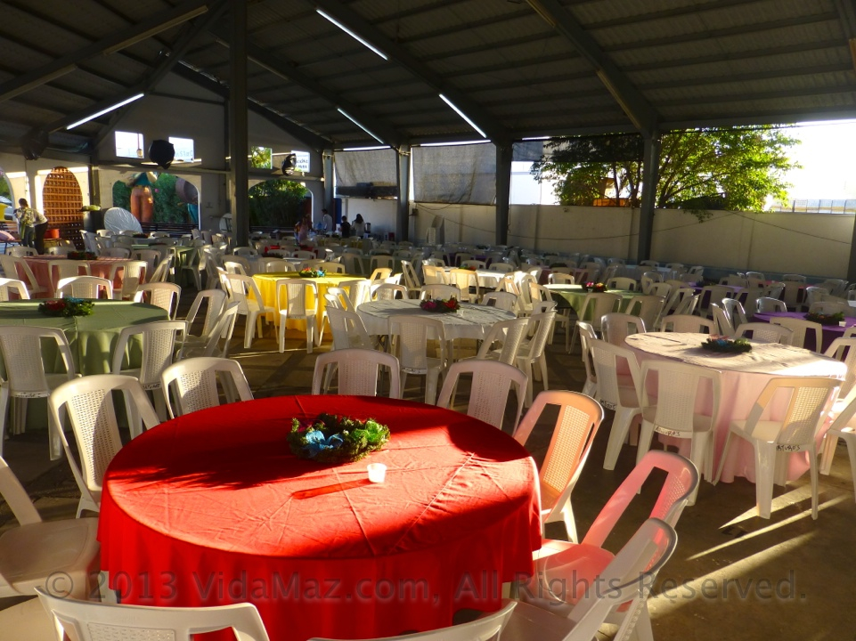
Set up or clean up the breakfast
Light plastic tables and chairs
Tablecloths
Salsa, napkins, centerpieces

Slide 15
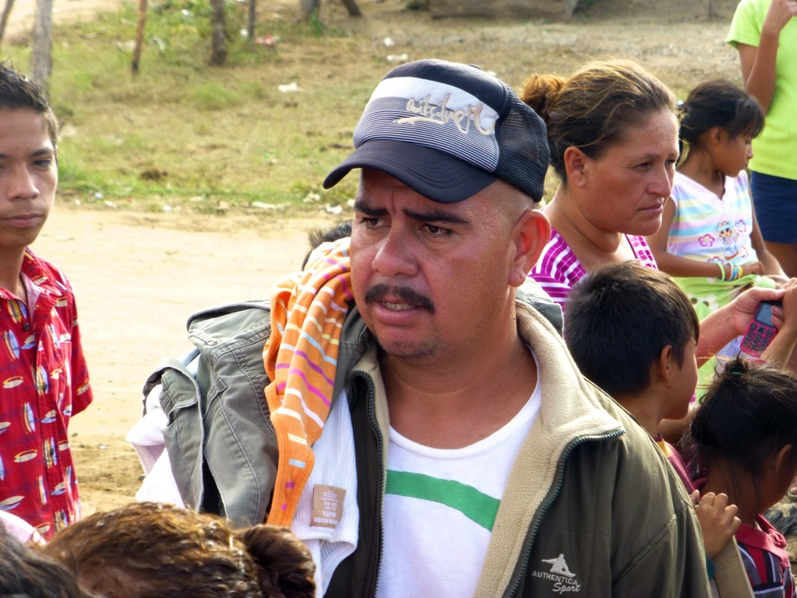
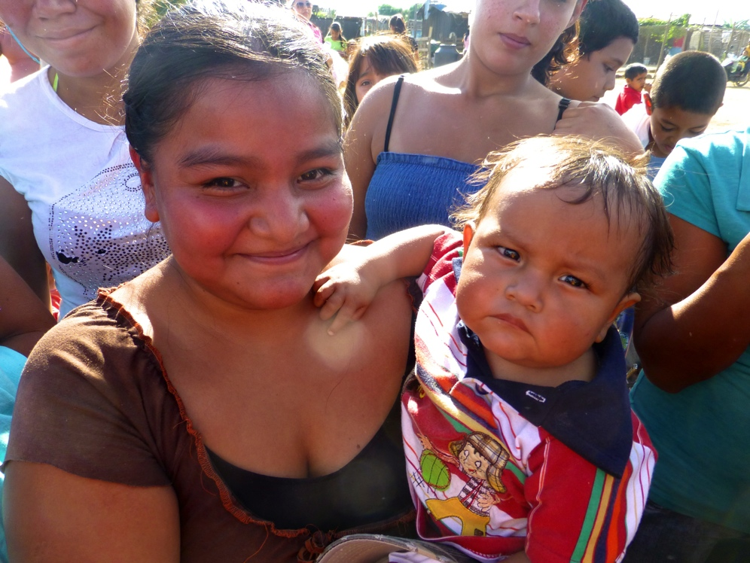
Collect gifts to give out
Gently used clothing
Gently used shoes
Blankets
Jackets
Especially baby and children’s items are needed
TOYS!
Candy

Slide 16
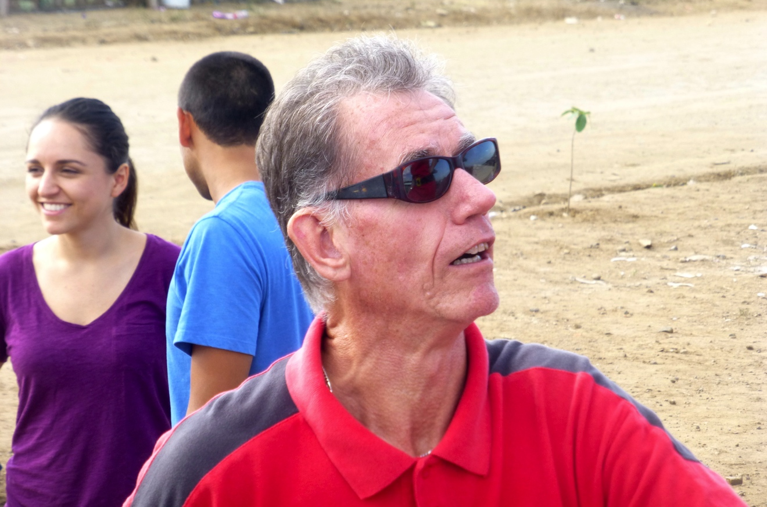
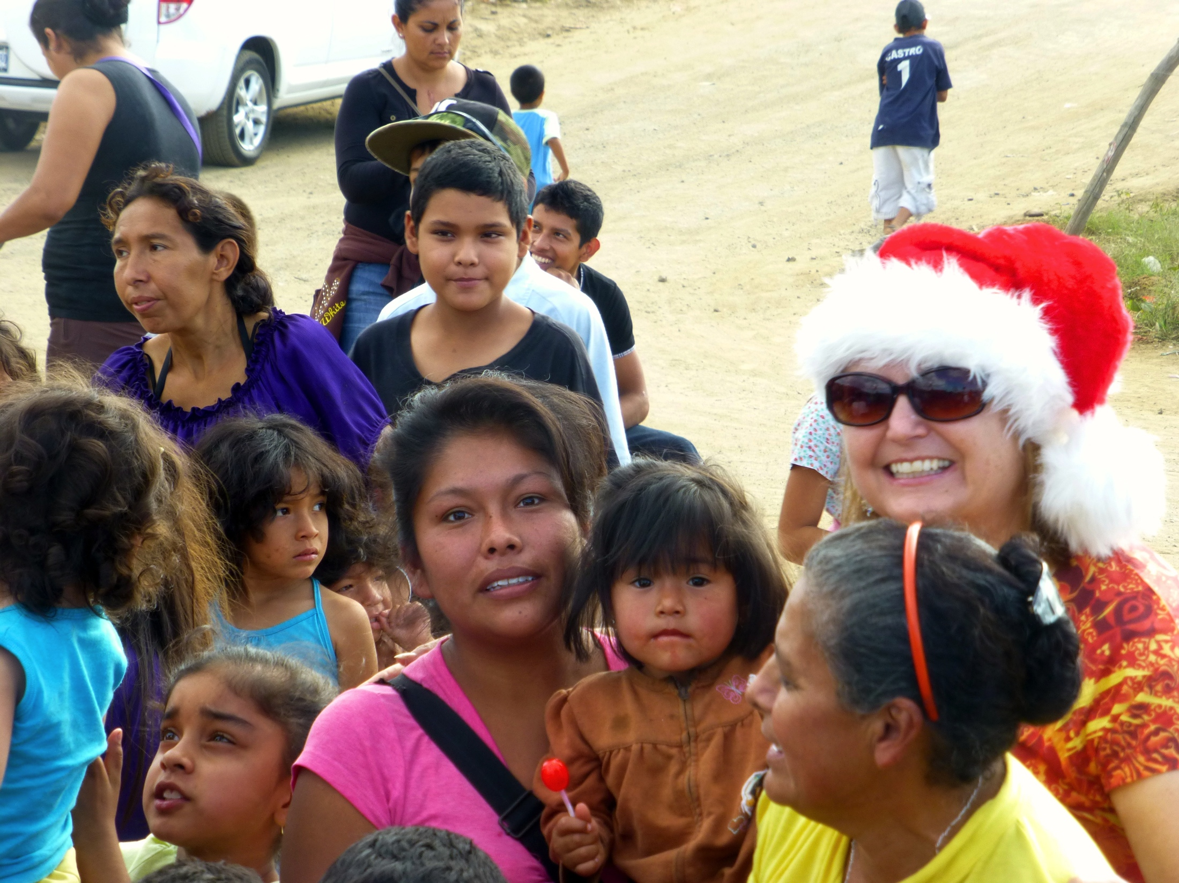
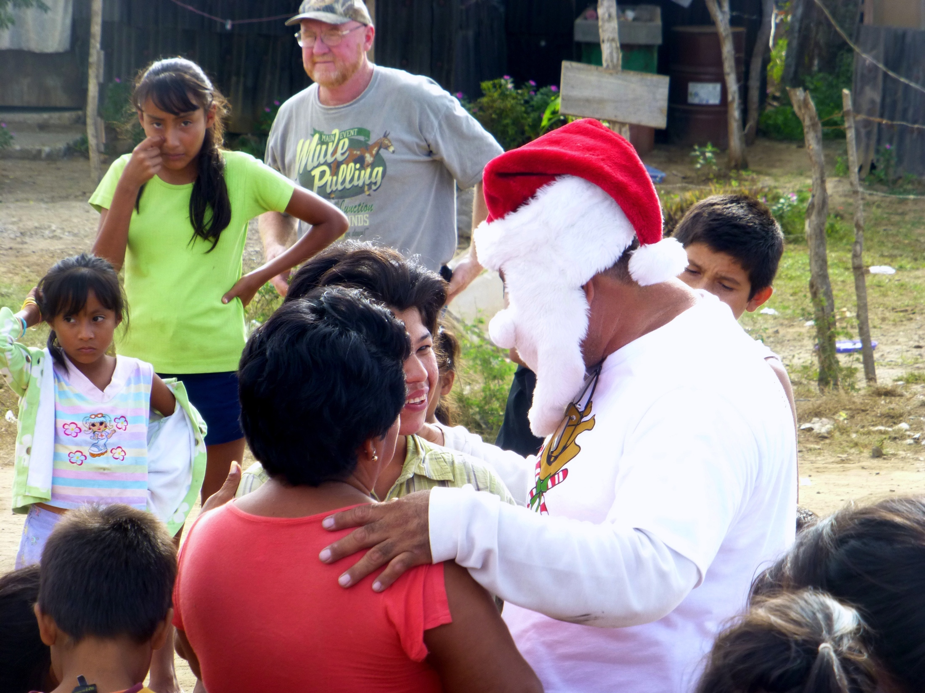

Slide 17
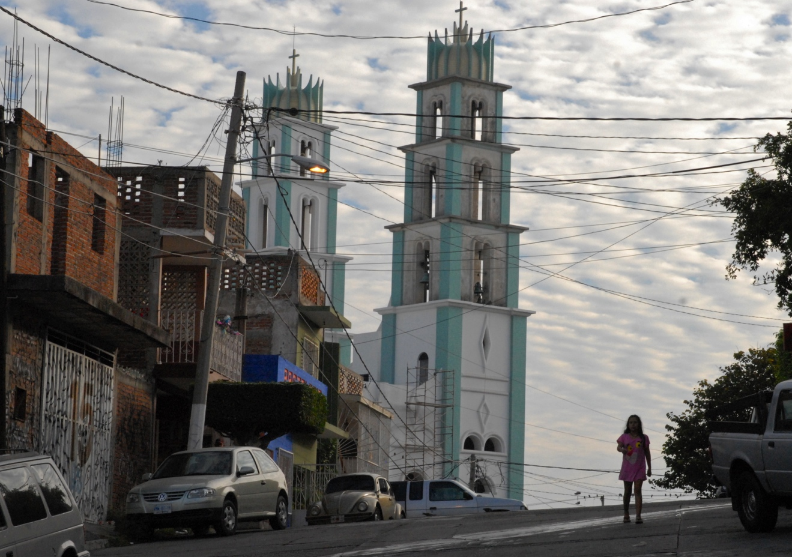
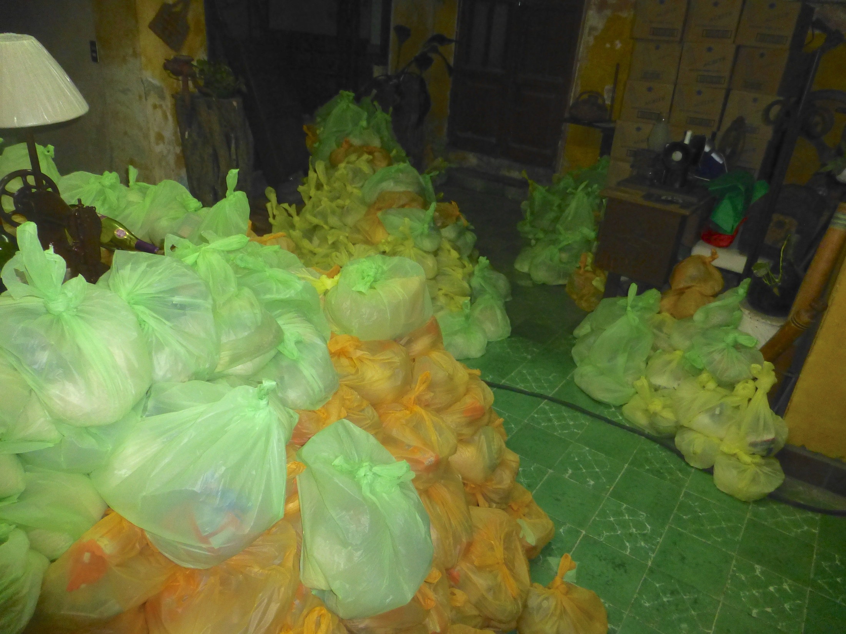
Pack Food
The days prior to Christmas Eve,
in the home of the Medina family in Quince Letras

Slide 18
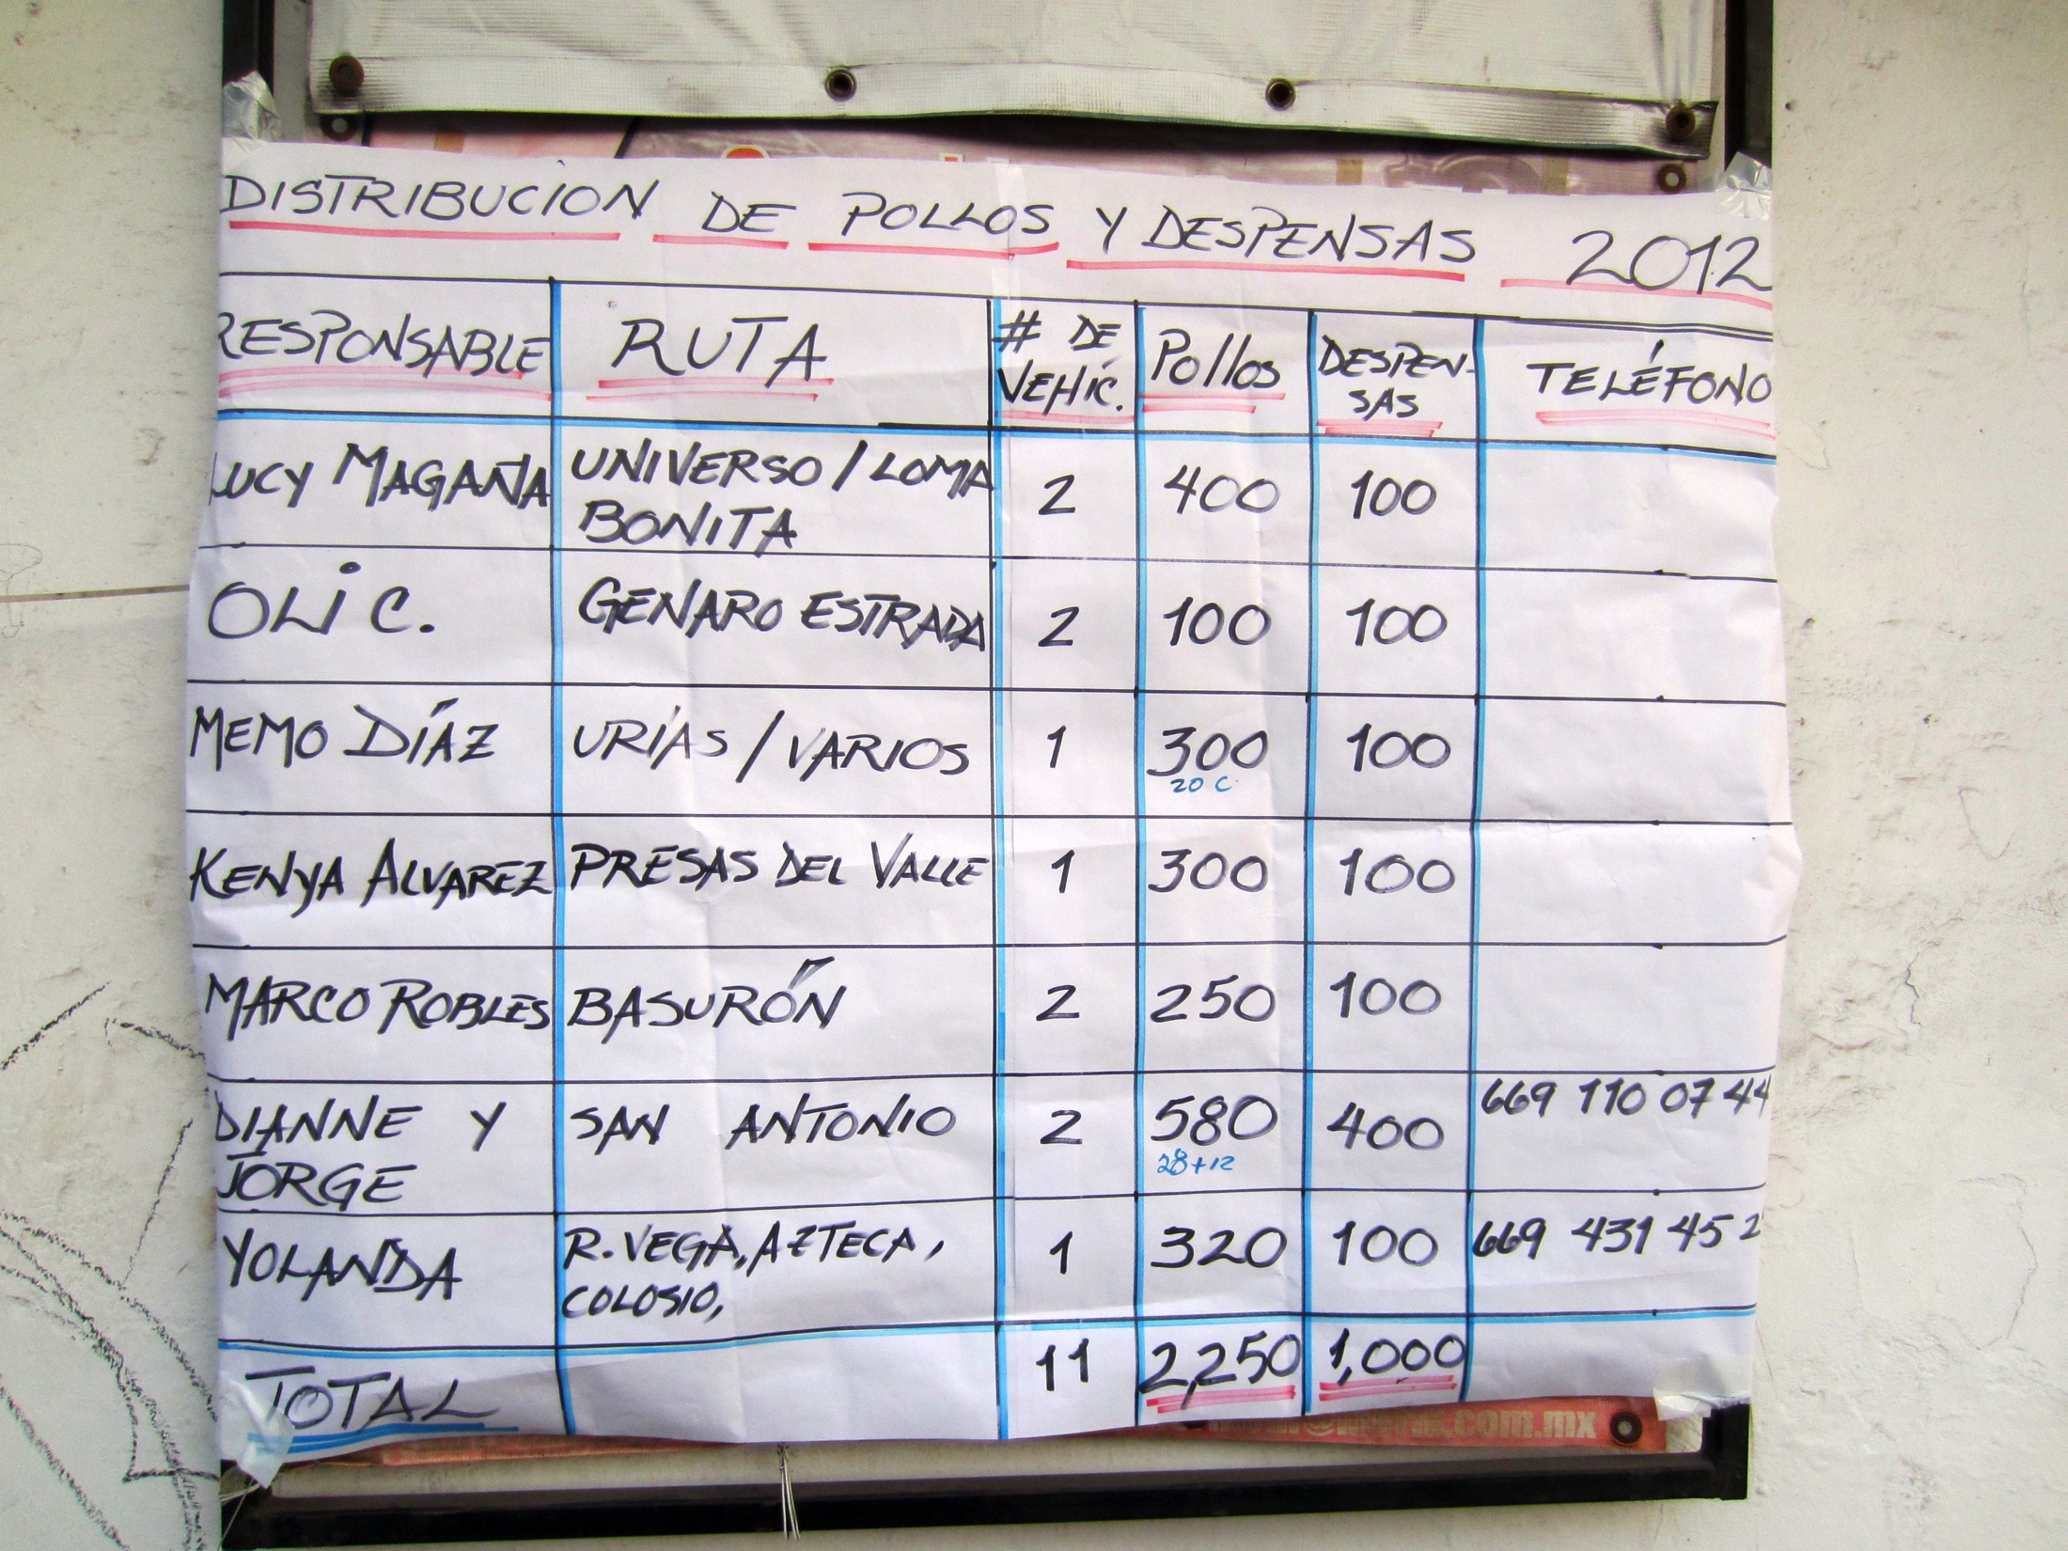
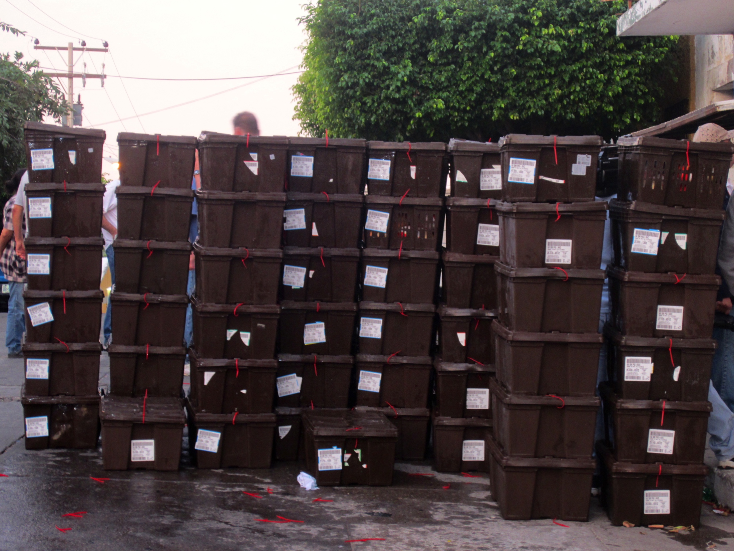
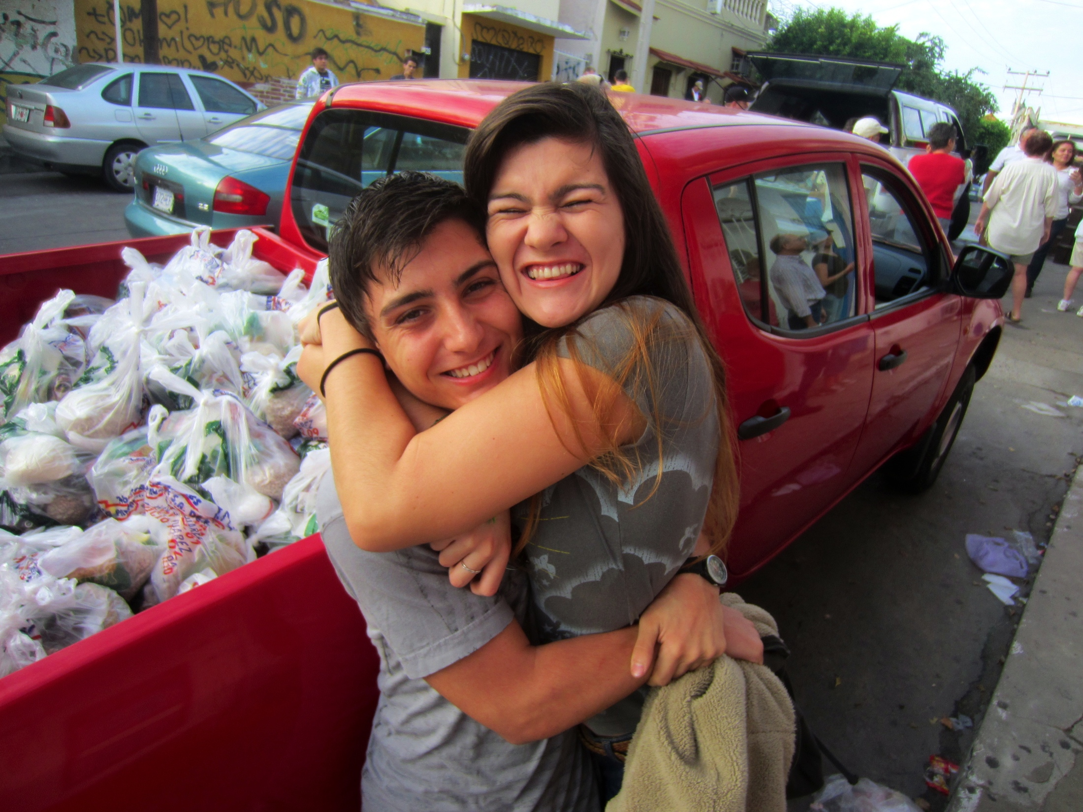
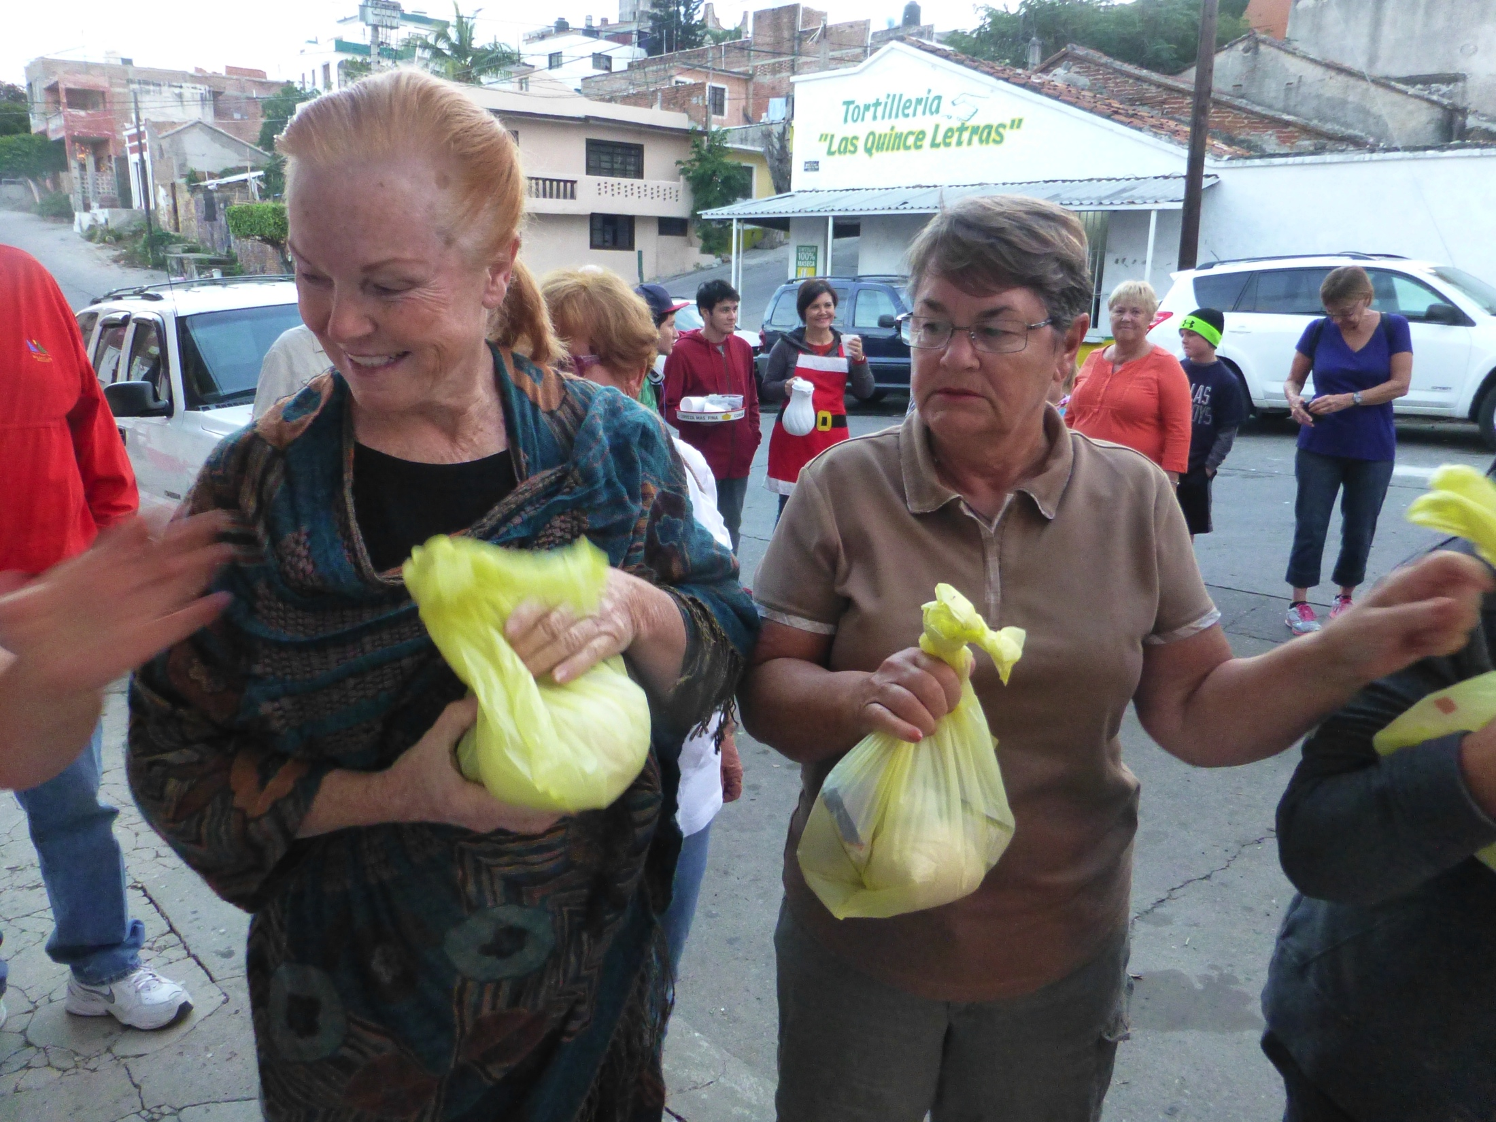
Bring Your Truck!
Join Us on the 24th of December

Slide 19
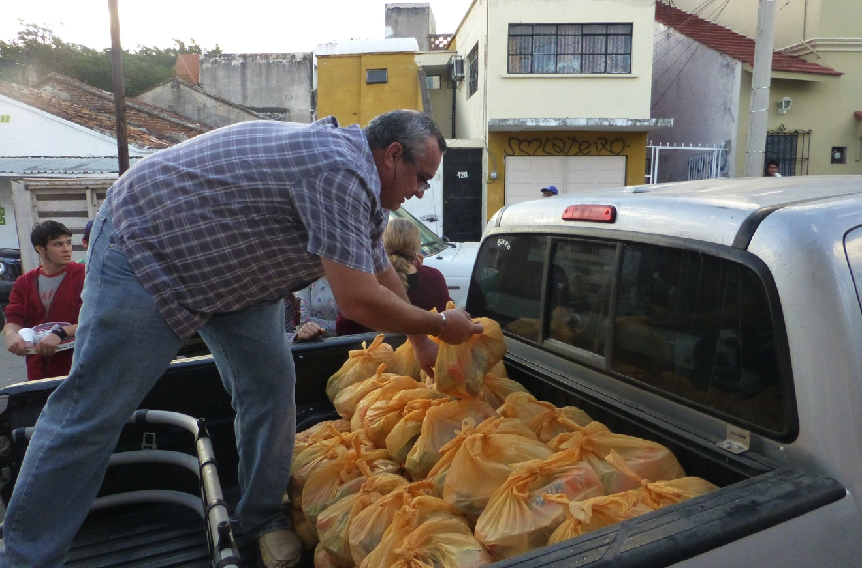
Donate Money or Food
The chickens are purchased from Bachoco. Some foodstuffs are obtained from the community pantry, but many are purchased. All gifts, auction and bazaar items are donated.

Slide 20
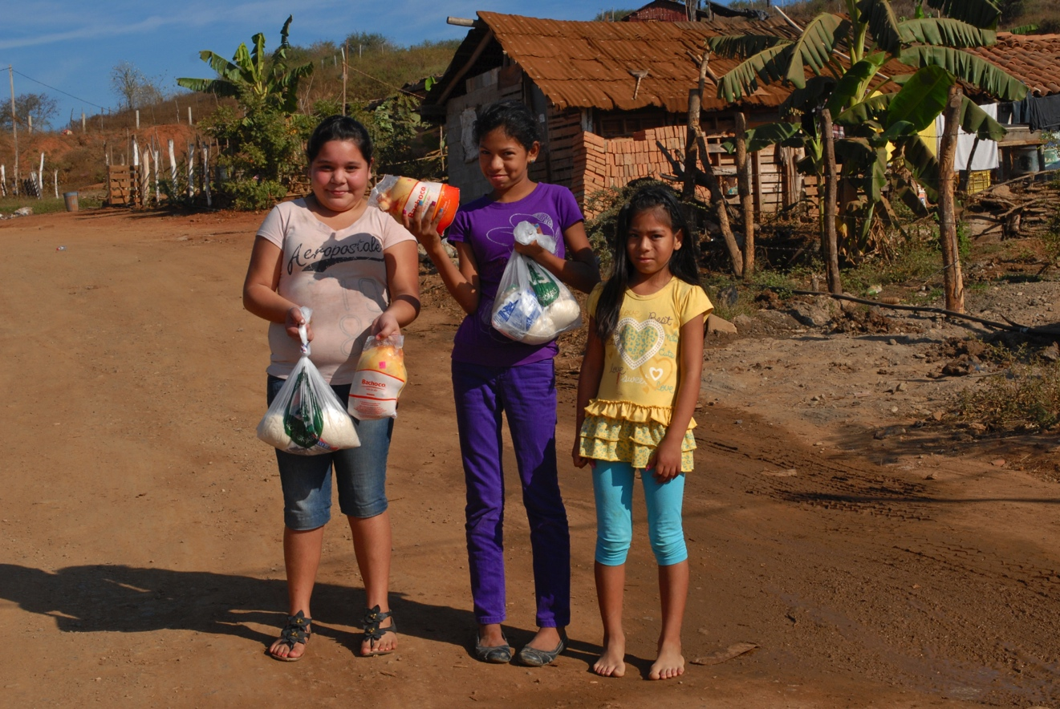
¡Gracias! Thank you!
Happy Holidays!
More Information: http://Pollos.VidaMaz.com

